Slide 1
Shri Shankaracharya Institute of Professional Management and technology, Mujgahan, Raipur Minor Project on Fitclick CSE 7th Semester Department of Computer science and engineering Batch 2018-2022 Session July-Dec 2021 Presentation Date: 05/10/21
Project Guide:
Mr. Devbrat Sahu (Assistant Professor, CSE)
Project Group Member:-
Abhishek Giri
Nitish Gupta
Yogesh Sonkar

Slide 2
Application Area
Why did you opt work on this project?
In this modern era where health is given priority, everyone wants to be physically fit and healthy. That’s the reason why we have decide to develop yoga app. In this fast-paced life where we have apps for almost everything such as media, games, entertainment, finance, and academics we also need an app to keep ourselves physically fit.
Applications and benefits of the project .
This app can be used by any person, irrespective of their ages.
Benefits:-
This app provides yoga's according to your health NEEDS.
This app will have a doctors phone no you can take appointment from the app itself.
Every morning and evening an yoga instructor will come online and will train you yoga
Who are the end users?
Anybody can use this app.

Slide 3
Project Overview
In this modern era where health is given priority, everyone wants to be physically fit and healthy. In this fast-paced life where we have webapp for almost everything such as media, games, entertainment, finance, and academics we also need an app to keep ourselves physically fit.
This is a webapp which anyone can access and they can access any yoga according to their problems.

Slide 4
Project Requirements (Developer)
Software used:
Adobe XD for UI/UX
HTML, CSS, JavaScript FOR FRONT-END
VS Code

Slide 5
Project Requirements (End User)
Requirements:
Personal Computer or Mobile Phone
Internet connectivity
Web Browser( Microsoft Edge or Chrome)

Slide 6
Front End Details
How many Interfaces / Screens your Application will have?
Three

Slide 7
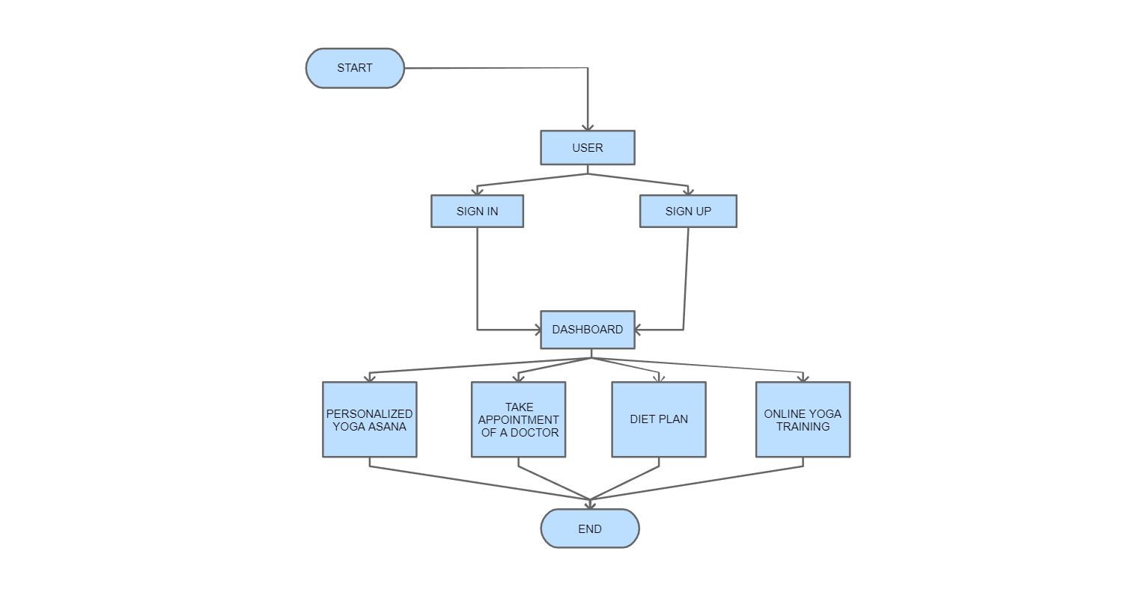
Project flow diagram

Slide 8
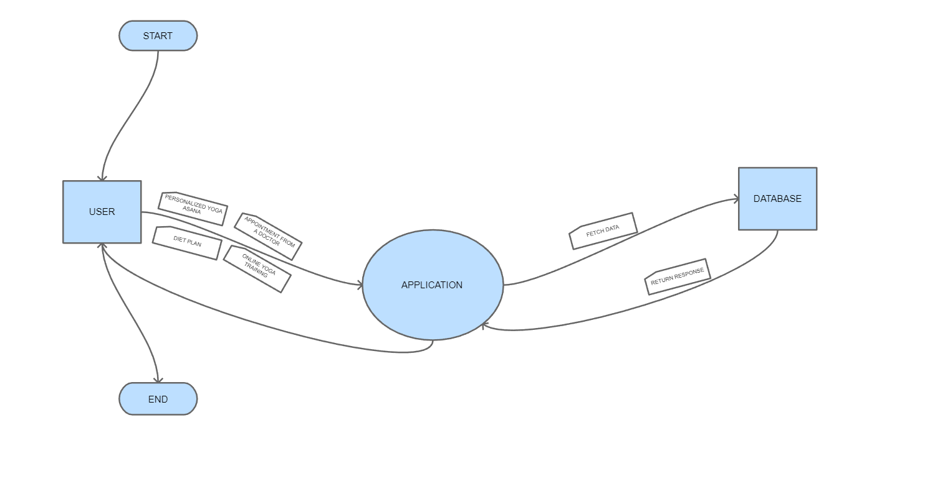
DFD 0

Slide 9
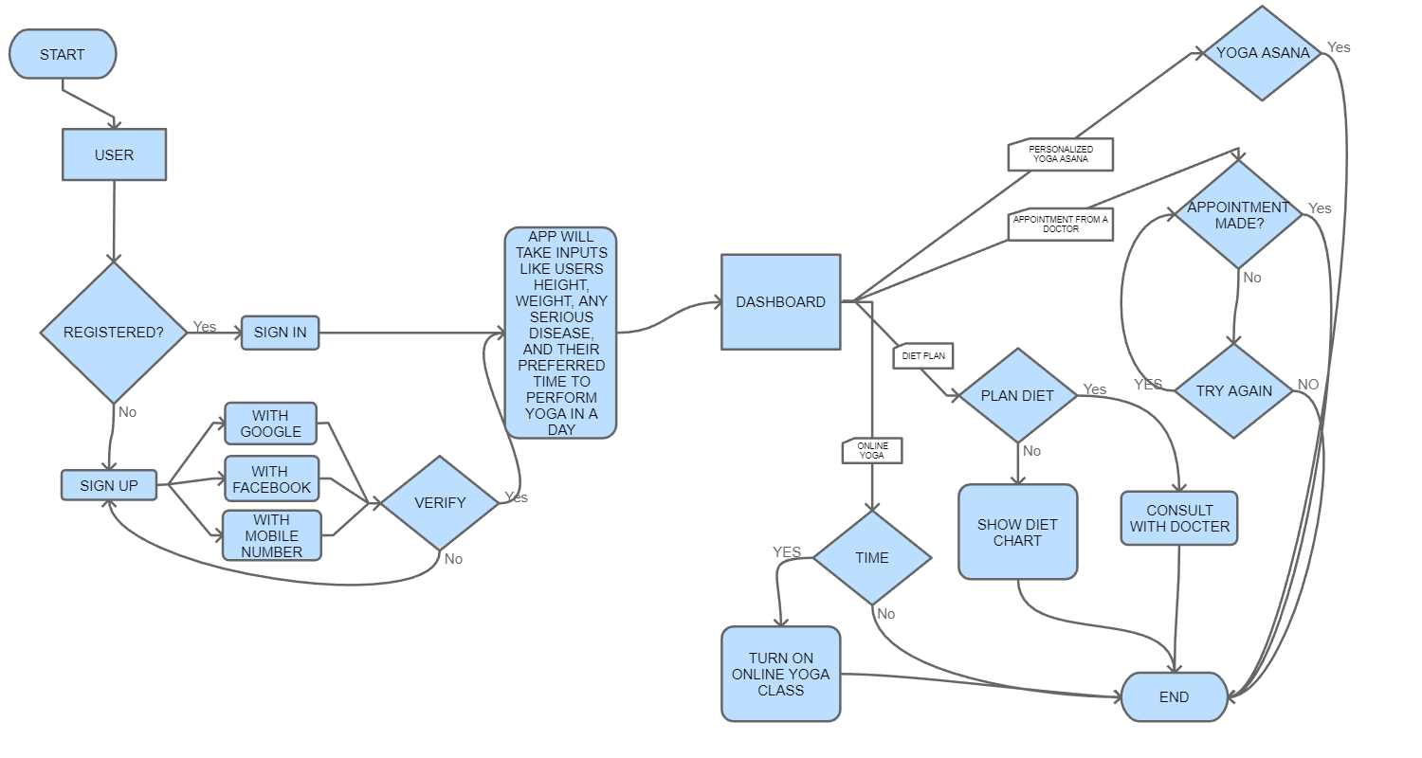
DFD1

Slide 10
Benefits and Conclusion
This app provides better physical health.
This app provides better mental health.
You don’t have to go anywhere to learn yoga you can learn in your home.
Cost effective

Slide 11
References
https://colorlib.com/wp/portfolio-tag/yoga/.
https://www.researchgate.net/publication/342916678_A_study_on_influence_of_yoga_on_student's_lif
https://www.youtube.com/watch?v=CGGF6MOOdrw&t=164s.
https://www.mdpi.com/1660-4601/17/19/6967.
https://en.wikipedia.org/wiki/Yoga

